Slide 1

Computer Organization & Assembly Language(CS-215T)
Lecture by:
Mr. Shakir Karim
Assistant Professor
DoCS&IT, SSUET
Batch 2022F

Slide 2
Week 1
Course Overview –Fundamental of Computer Design and Basic Models
Computer Science & Information Technology Department
Sir Syed University of Engg. & Tech.
Lecture by: Mr. Shakir Karim

Slide 3
Course Overview
Course Objective:
The objective of this course is to explain the concepts of computer organization in relation with Intel 8086/88 instruction set architecture. The concepts of Assembly language programming for the Intel 8086/88 related to assembling and linking programs, addressing modes, program control flow, arithmetic and logical operations, ASCII and BCD arithmetic, procedure calls, and string manipulation will be discussed. Students will understand the design issues that can affect the performance of a computer system, including the elements and design concept of cache memory using different mapping techniques.
Computer Science & Information Technology Department
Sir Syed University of Engg. & Tech.
Lecture by: Mr. Shakir Karim

Slide 4
Course Overview /2
Lecture Breakups:
16 weeks of lectures with recommended reading mentioned for every lecture
Computer Science & Information Technology Department
Sir Syed University of Engg. & Tech.
Lecture by: Mr. Shakir Karim

Slide 5
Course Overview /3
Text Book:
Computer Organization & Architecture, Design for Performance, 11/ed. 2019
by William Stallings
ISBN-13:978-0-13-410161-3,
Pearson Prentice Hall
Computer Science & Information Technology Department
Sir Syed University of Engg. & Tech.
Lecture by: Mr. Shakir Karim

Slide 6
Course Overview /3
Text Book:
Computer Organization & Architecture, Design for Performance, 11/ed. 2019
by William Stallings
ISBN-13:978-0-13-410161-3,
Pearson Prentice Hall
Computer Science & Information Technology Department
Sir Syed University of Engg. & Tech.
Lecture by: Mr. Shakir Karim

Slide 7
Course Overview /4
Reference Book:
The Essentials of Computer Organization &Architecture,
by Linda Null & Julia Lobur
ISBN: 0-7637-0444-X
The 80x86 IBM PC and Compatible Computers (Vol. I & II) Assembly Language, Design, and Interfacing (4th Ed.)
by Muhammad Ali Mazidi and Janice Gillispie Mazidi Pearson Education, Inc.
Computer Science & Information Technology Department
Sir Syed University of Engg. & Tech.
Lecture by: Mr. Shakir Karim

Slide 8
Course Overview /6
Why This Course?
Express your views in 60 seconds for following in
no more than 3 sentences each. Write your views in your own words
What is your expectation from this course? (60 sec)
What do you want to learn in this course? (60 sec)
Why is this course important for you as a Computer Science student? (60 sec)
Computer Science & Information Technology Department
Sir Syed University of Engg. & Tech.
Lecture by: Mr. Shakir Karim

Slide 9

Computer, Architecture, Organization?
What do we know about these terms?
Computer?
کمپیوٹر
Architecture?
تعمیر کا فن اور علم
Organization?
تنظیم
Let’s explore!
Literal meanings
Computer Science & Information Technology Department
Sir Syed University of Engg. & Tech.
Lecture by: Mr. Shakir Karim

Slide 10
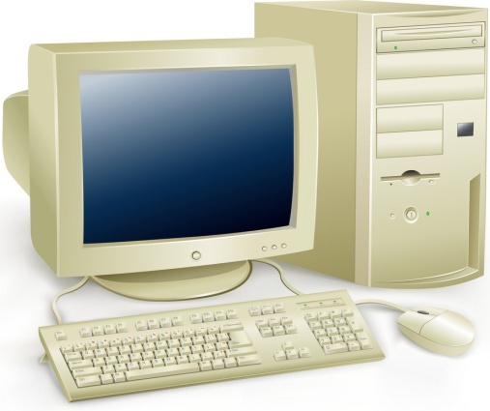

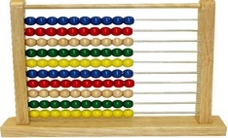


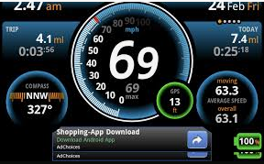
Let’s Explore
The journey starts from the term
COMPUTER
Computer Science & Information Technology Department
Sir Syed University of Engg. & Tech.
Lecture by: Mr. Shakir Karim

Slide 11
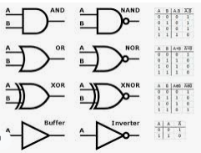
Let’s Explore / 2
What do these all devices do?
They all compute!
What do they require to compute?
Operations +, -, *, /
What else?
Logic!
Computer Science Department
Sir Syed University of Engg. & Tech.
Lecture by: Mr. Shakir Karim

Slide 12
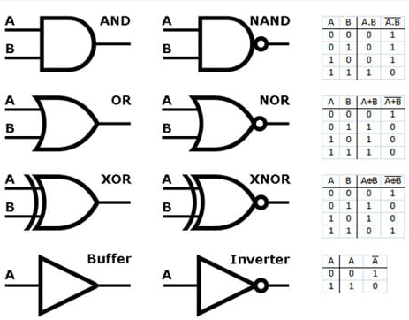
Let’s Explore / 3
Computer Science & Information Technology Department
Sir Syed University of Engg. & Tech.
Lecture by: Mr. Shakir Karim

Slide 13
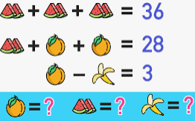
Logic…
Computer Science & Information Technology Department
Sir Syed University of Engg. & Tech.
Lecture by: Mr. Shakir Karim

Slide 14
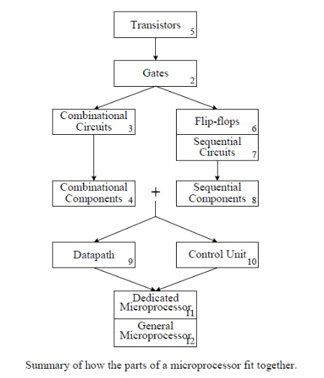
Computer Science & Information Technology Department
Sir Syed University of Engg. & Tech.
Lecture by: Mr. Shakir Karim

Slide 15
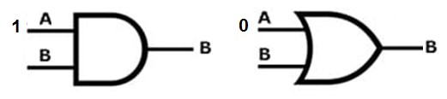
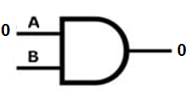
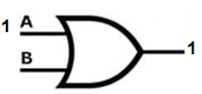
DLD - revisit
Dependency Rule for AND & OR Logic:
“Masking” – An Application of AND Logic:
“Setting” – An Application of OR Logic:
Computer Science & Information Technology Department
Sir Syed University of Engg. & Tech.
Lecture by: Mr. Shakir Karim

Slide 16
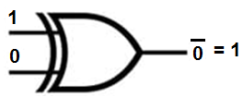
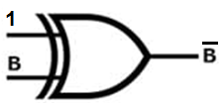
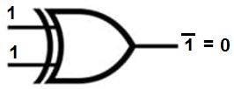
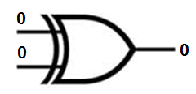
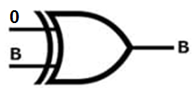
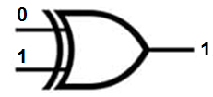
DLD - revisit
Application of XOR gate
XOR as an Inverter
XOR as a Buffer
Computer Science & Information Technology Department
Sir Syed University of Engg. & Tech.
Lecture by: Mr. Shakir Karim

Slide 17
DLD - revisit
Combinational Logic involves
Adder, Subtractor, Encoder, Multiplexer, Decoder/De-Multiplexer, Comparator
A – B = A + ( - B )
Subtraction can be implemented using
2’s complement addition
Computer Science & Information Technology Department
Sir Syed University of Engg. & Tech.
Lecture by: Mr. Shakir Karim

Slide 18
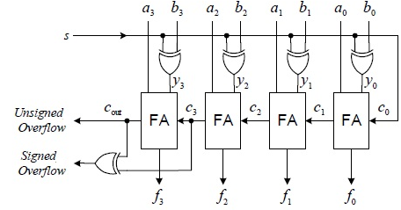

DLD - revisit
Adder-Subtractor Circuit
Computer Science & Information Technology Department
Sir Syed University of Engg. & Tech.
Lecture by: Mr. Shakir Karim

Slide 19
DLD - revisit
Adder-Subtractor Circuit
Computer Science & Information Technology Department
Sir Syed University of Engg. & Tech.
Lecture by: Mr. Shakir Karim

Slide 20
DLD - revisit
Adder-Subtractor Circuit
Computer Science & Information Technology Department
Sir Syed University of Engg. & Tech.
Lecture by: Mr. Shakir Karim

Slide 21
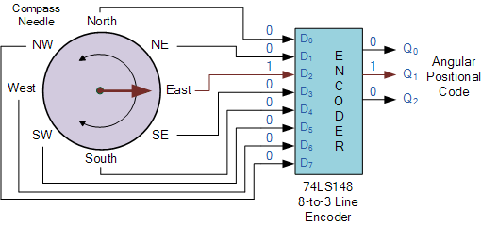
DLD - revisit
An Application of Encoder
Computer Science & Information Technology Department
Sir Syed University of Engg. & Tech.
Lecture by: Mr. Shakir Karim

Slide 22
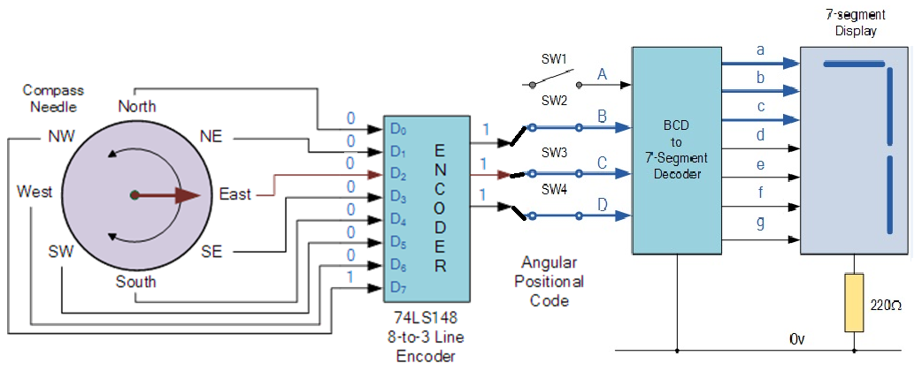
DLD - revisit
Combination of Encoder and Decoder
Computer Science & Information Technology Department
Sir Syed University of Engg. & Tech.
Lecture by: Mr. Shakir Karim

Slide 23
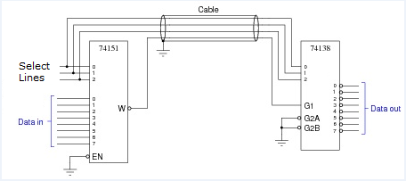
DLD - revisit
Combination of MUX and De-MUX
Computer Science & Information Technology Department
Sir Syed University of Engg. & Tech.
Lecture by: Mr. Shakir Karim

Slide 24
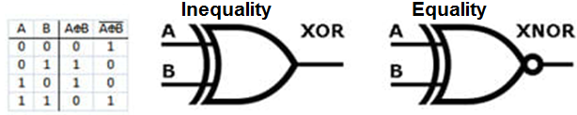
DLD - revisit
Combinational Logic involves
Adder, Subtractor, Encoder, Multiplexer, Decoder/De-Multiplexer, Comparator
Computer Science & Information Technology Department
Sir Syed University of Engg. & Tech.
Lecture by: Mr. Shakir Karim

Slide 25
DLD - revisit
Concept of Universal Gates
Origin: De Morgan’s Theorem
(i) (A . B)’ = A’ + B’
(ii) (A+B)’ = A’ . B’
Computer Science & Information Technology Department
Sir Syed University of Engg. & Tech.
Lecture by: Mr. Shakir Karim

Slide 26
DLD - revisit
Sequential Logic involves Memory which is implemented by Flip-Flops and Latches
Flip-Flops and Latches are basic unit of a Memory
A Flip-Flop or Latch can be considered as a bit
Register is used as a container
Register is combination of latches
Computer Science & Information Technology Department
Sir Syed University of Engg. & Tech.
Lecture by: Mr. Shakir Karim

Slide 27
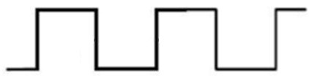
DLD - revisit
Related Concepts
Duty-cycle = ON time / (ON time + OFF time)
OFF time
ON time
Computer Science & Information Technology Department
Sir Syed University of Engg. & Tech.
Lecture by: Mr. Shakir Karim

Slide 28
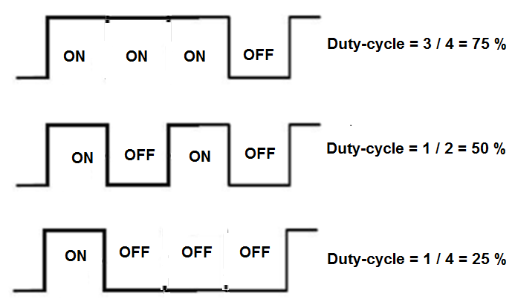
DLD - revisit
Related Concepts
Duty-cycle = ON time / (ON time + OFF time)
Computer Science & Information Technology Department
Sir Syed University of Engg. & Tech.
Lecture by: Mr. Shakir Karim

Slide 29
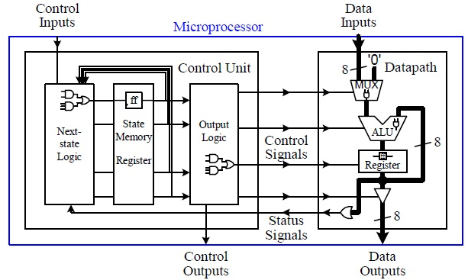
The Bigger Picture
Fundamentals of Computer design
Source: Digital Logic and Microprocessor Design with VHDL by Enoch O. Hwang
Computer Science & Information Technology Department
Sir Syed University of Engg. & Tech.
Lecture by: Mr. Shakir Karim

Slide 30
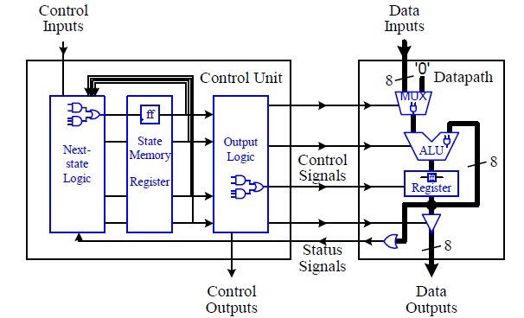
Digital Circuit
Source: Digital Logic and Microprocessor Design with VHDL by Enoch O. Hwang
Computer Science & Information Technology Department
Sir Syed University of Engg. & Tech.
Lecture by: Mr. Shakir Karim

Slide 31
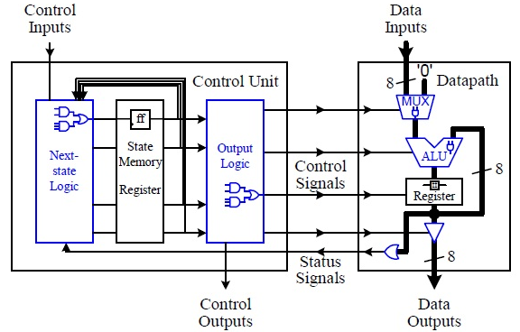
Combinational Circuit
Source: Digital Logic and Microprocessor Design with VHDL by Enoch O. Hwang
Computer Science & Information Technology Department
Sir Syed University of Engg. & Tech.
Lecture by: Mr. Shakir Karim

Slide 32
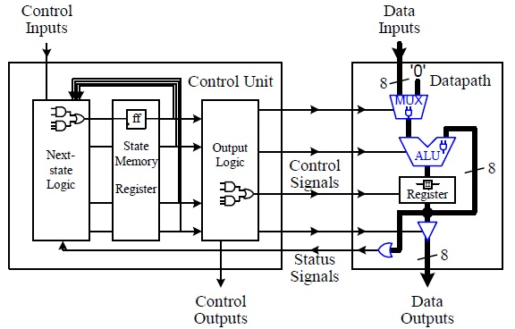
Standard Combinational Components
Source: Digital Logic and Microprocessor Design with VHDL by Enoch O. Hwang
Computer Science & Information Technology Department
Sir Syed University of Engg. & Tech.
Lecture by: Mr. Shakir Karim

Slide 33
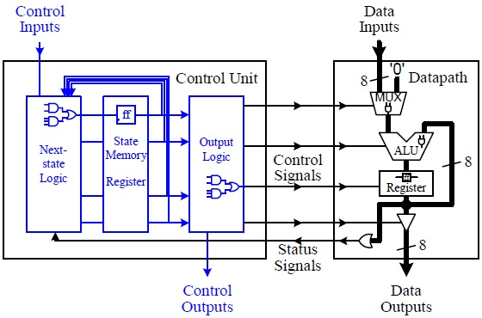
Sequential Circuit
Source: Digital Logic and Microprocessor Design with VHDL by Enoch O. Hwang
Computer Science & Information Technology Department
Sir Syed University of Engg. & Tech.
Lecture by: Mr. Shakir Karim

Slide 34
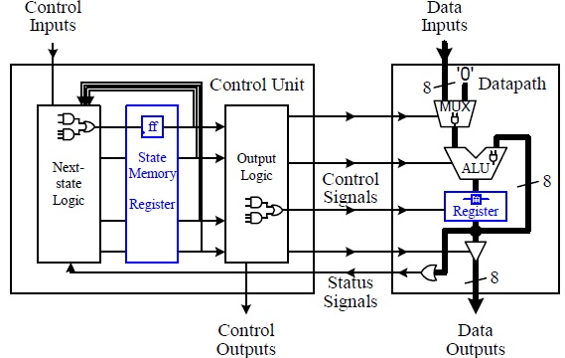
Standard Sequential Components
“Latches & Flip-Flops”
Source: Digital Logic and Microprocessor Design with VHDL by Enoch O. Hwang
Computer Science & Information Technology Department
Sir Syed University of Engg. & Tech.
Lecture by: Mr. Shakir Karim

Slide 35
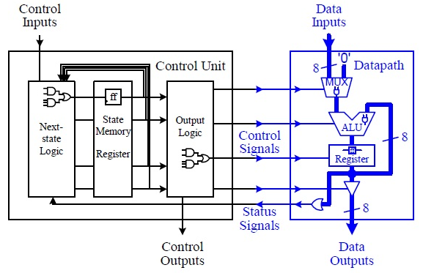
Datapath
Source: Digital Logic and Microprocessor Design with VHDL by Enoch O. Hwang
Computer Science & Information Technology Department
Sir Syed University of Engg. & Tech.
Lecture by: Mr. Shakir Karim

Slide 36
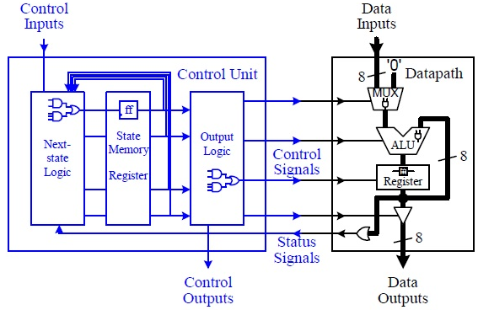
Control units
Source: Digital Logic and Microprocessor Design with VHDL by Enoch O. Hwang
Computer Science & Information Technology Department
Sir Syed University of Engg. & Tech.
Lecture by: Mr. Shakir Karim

Slide 37
Computer Architecture
Logical Aspects of a computer system
Focuses on the structure and behavior of a computer system
Attributes of a system that are visible to the programmer
Attributes such as Instruction Set, Data Type representation in number of bits, I/O Mechanism, Memory Addressing Techniques
Computer Science & Information Technology Department
Sir Syed University of Engg. & Tech.
Lecture by: Mr. Shakir Karim

Slide 38
Computer Organization
Physical aspects of a computer system
Study on how various circuits and components fit together to create a working computer
Attributes of a system that are not visible to the programmer such as operational units and interconnects
Attributes such as control signals, interfaces between computer and peripherals, memory technology used
Computer Science & Information Technology Department
Sir Syed University of Engg. & Tech.
Lecture by: Mr. Shakir Karim

Slide 39
In one sentence…
Computer Architecture helps to answer
How do we design a computer?
Computer Organization helps to answer
How does a computer work?
Computer Science & Information Technology Department
Sir Syed University of Engg. & Tech.
Lecture by: Mr. Shakir Karim

Slide 40
Why is it necessary to study?
Specially for a computer science students!
Viewpoint can be based on the
Principle of Equivalence of Hardware and Software
Computer Scientists -> Complex Algorithms
Complex Algorithms -> Implementation
Implementation -> Hardware Specifications
Computer Science & Information Technology Department
Sir Syed University of Engg. & Tech.
Lecture by: Mr. Shakir Karim

Slide 41

MIT Cheetah
Computer Science Department
Sir Syed University of Engg. & Tech.
Lecture by: Mr. Shakir Karim

Slide 42
Do You know…
The difference between K and k?
Which ‘kilo’ is associated with base10 and
Which ‘kilo’ is associated with base2?
How many bytes are there in a Kilo of base2?
How many bits are there in 16 Kilo Bytes?
Add 2022 to your three digit roll# and represent the result in Binary and Hexadecimal number systems?
Computer Science & Information Technology Department
Sir Syed University of Engg. & Tech.
Lecture by: Mr. Shakir Karim

Slide 43
The computer level Hierarchy
Level 6 (User)
Level 2 (Machine)
Level 0 (Digital Logic)
Level 5 (High Level Language)
Level 4 (Assembly Language)
Level 3 (System Software)
Level 1 (Control)
Divide & Conquer!!!
Computer Science & Information Technology Department
Sir Syed University of Engg. & Tech.
Lecture by: Mr. Shakir Karim

Slide 44
The computer level Hierarchy
Example of each level:
Level 6 Executable Programs
Level 5 C++, Java, Fortran etc.
Level 4 Assembly Code
Level 3 Operating System, Library Code
Level 2 Instruction Set Architecture
Level 1 Microcode or Hardwired
Level 0 Circuits, Gates etc.
Computer Science & Information Technology Department
Sir Syed University of Engg. & Tech.
Lecture by: Mr. Shakir Karim

Slide 45
Structure & Function
Previously we have discussed the
hierarchical nature of a computer system
At each hierarchical level designer is concerned with
Structure
  The way in which components interrelate
Function
  Operation of each individual component
Data Processing
Data Storage
Main Memory
CPU
Function
  Four basic Functions of a computer
Structure
  Four main Structural components
Data Movement
Control
I/O
System
Interconnect
Peripherals
Data Communication
Computer Science & Information Technology Department
Sir Syed University of Engg. & Tech.
Lecture by: Mr. Shakir Karim

Slide 46
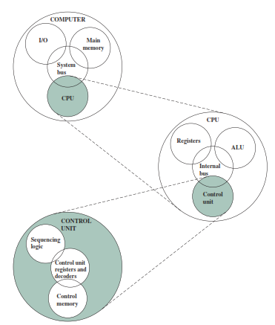
Top Level Structure
Computer Science & Information Technology Department
Sir Syed University of Engg. & Tech.
Lecture by: Mr. Shakir Karim

Slide 47
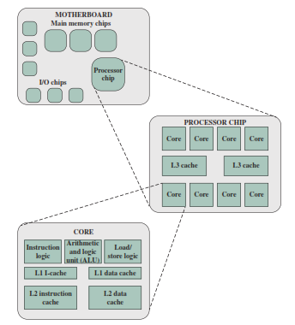
Multicore Computer Structure
Functional elements of a core are:
Instruction Unit
Arithmetic Logic Unit
Load / Store Logic
Computer Science & Information Technology Department
Sir Syed University of Engg. & Tech.
Lecture by: Mr. Shakir Karim

Slide 48
Sub-Area within the Core
ISU Instruction Sequence Unit
IFU Instruction Fetch Unit
IDU Instruction Decode Unit
LSU Load/Store Unit
XU Translation Unit
FXU Fixed-point Unit
BFU Binary Floating-point Unit
DFU Decimal Floating-point Unit
RU Recovery Unit
Computer Science & Information Technology Department
Sir Syed University of Engg. & Tech.
Lecture by: Mr. Shakir Karim

Slide 49
The computer Basic Models
Von Neumann Model
Non Von Neumann Model
Computer Science & Information Technology Department
Sir Syed University of Engg. & Tech.
Lecture by: Mr. Shakir Karim

Slide 50
Von Neumann Model
  Proposed by a Mathematician Von Neumann
  Followed by all stored-program computer
  Possess following characteristics
    Central Processing Unit
    Arithmetic Logic Unit
    Registers
    Main Memory Unit
    I/O Systems
  Bottleneck is the single path for transferring data and instructions
Computer Science & Information Technology Department
Sir Syed University of Engg. & Tech.
Lecture by: Mr. Shakir Karim

Slide 51
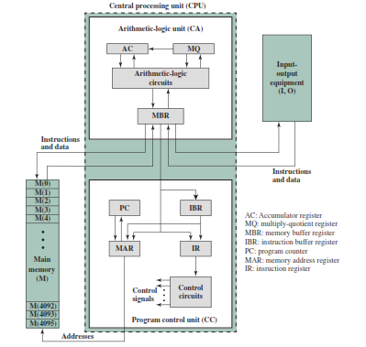
Von Neumann Model
Computer Science & Information Technology Department
Sir Syed University of Engg. & Tech.
Lecture by: Mr. Shakir Karim

Slide 52
Non Von Neumann Model
  AKA Harvard Architecture
  Proposed solution to Von Neumann Bottleneck
  Two buses for data and instructions each
  Data and Instructions are simultaneously transferred
  Mostly used to design special purpose machine
Computer Science & Information Technology Department
Sir Syed University of Engg. & Tech.
Lecture by: Mr. Shakir Karim

Slide 53
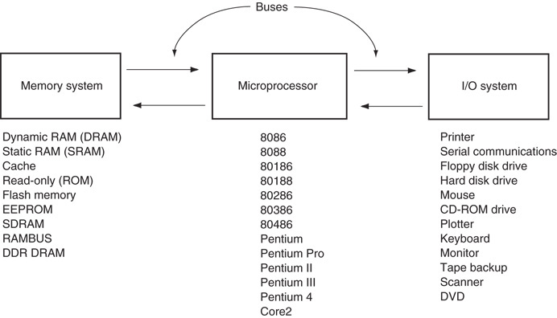
The block diagram of a microprocessor-based computer system
Computer Science & Information Technology Department
Sir Syed University of Engg. & Tech.
Lecture by: Mr. Shakir Karim

Slide 54
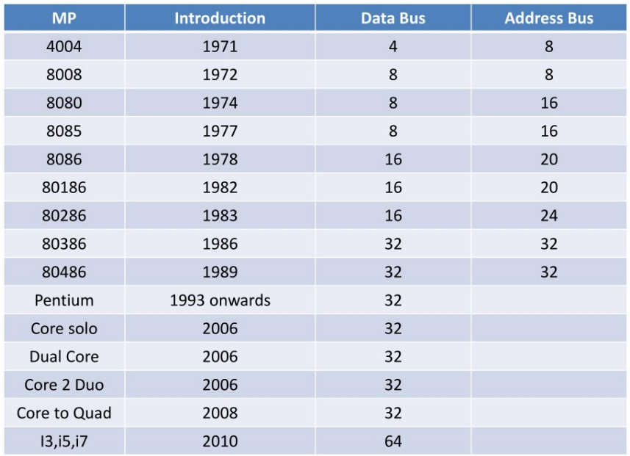
History of Intel x86 Microprocessor
Computer Science & Information Technology Department
Sir Syed University of Engg. & Tech.
Lecture by: Mr. Shakir Karim

